Slide 1

Detecting Criminal Wallets
STUDENTS
INSTRUCTOR
Nehoray Chalfon
Ofer Zevin
Ori Sinvani
Github repo
Harel Brener
Group 4

Slide 2


QUICK REFRESHER
Goal & Motivation
Our Approach
Classify Bitcoin addresses as benign or criminal based solely on-chain activity.
Ego-graph GNN: Constructing a depth-1 ego-graph for each wallet.
Improved tools are vital for identifying financial abuse and strengthening global crypto-security.
Processing via a 3-layer GATv2 attention network utilizing both node and edge feature vectors.

Slide 3
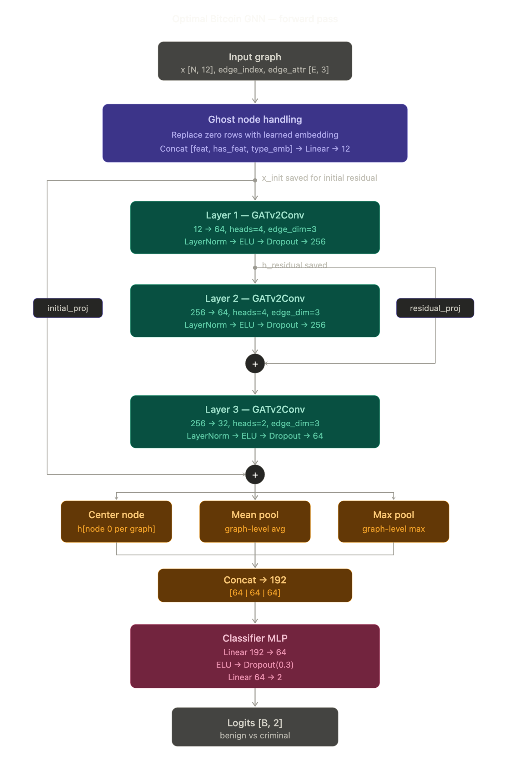
ARCHITECTURE CHANGES
GATv2: 3-layer architecture with multi-head attention (4 → 4 → 2 heads).
Ghost-node: Learnable 12-d + node-type embeddings for featureless neighbors.
Regularization: DropEdge (p=0.1) implemented during training phase.
Dual Residuals: Layer-1→2 (gradient flow) and Input→Post-L3 (signal preservation).
Hybrid Readout: Center node + Mean/Max pooling → 192-d vector.
Post-hoc: MLP head (192→64→2) with Temperature Scaling (T=1.077).

Slide 4
METRICS COMPARISON - POST MARATHON
Metric | v1.0.0 (M) | Current (Post-changes) | Absolute Gain
Accuracy | 81.10% | 88.39% | +7.29%
F1 (Criminal) | 80.91% | 88.64% | +7.73%
Recall (Criminal) | 80.10% | 91.29% | +11.19%
Precision (Benign) | 80.49% | 90.88% | +10.39%
ROC-AUC | 88.78% | 95.37% | +6.59%
PR-AUC | 88.31% | 95.17% | +6.86%

Slide 5

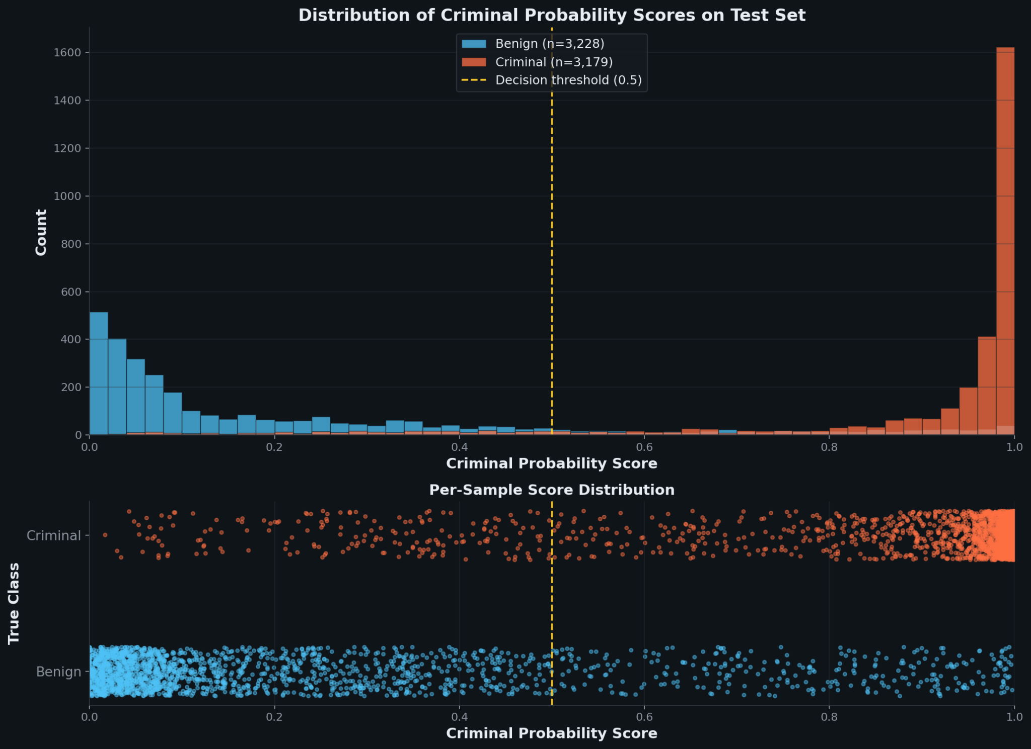
SCORE DISTRIBUTION ANALYSIS
The model exhibits strong class separation, effectively distinguishing criminal wallets from the baseline population.
Key Insights
01. Bimodal Distribution
The test set results show clear peaks at extreme ends, indicating high confidence in binary classifications.
02. Probability Thresholds
Minimal overlap between classes at the 0.5 threshold suggests a highly discriminative feature space.
03. Calibration Consistency
Per-sample scores align with density peaks, confirming the model's robustness across diverse wallet types.

Slide 6
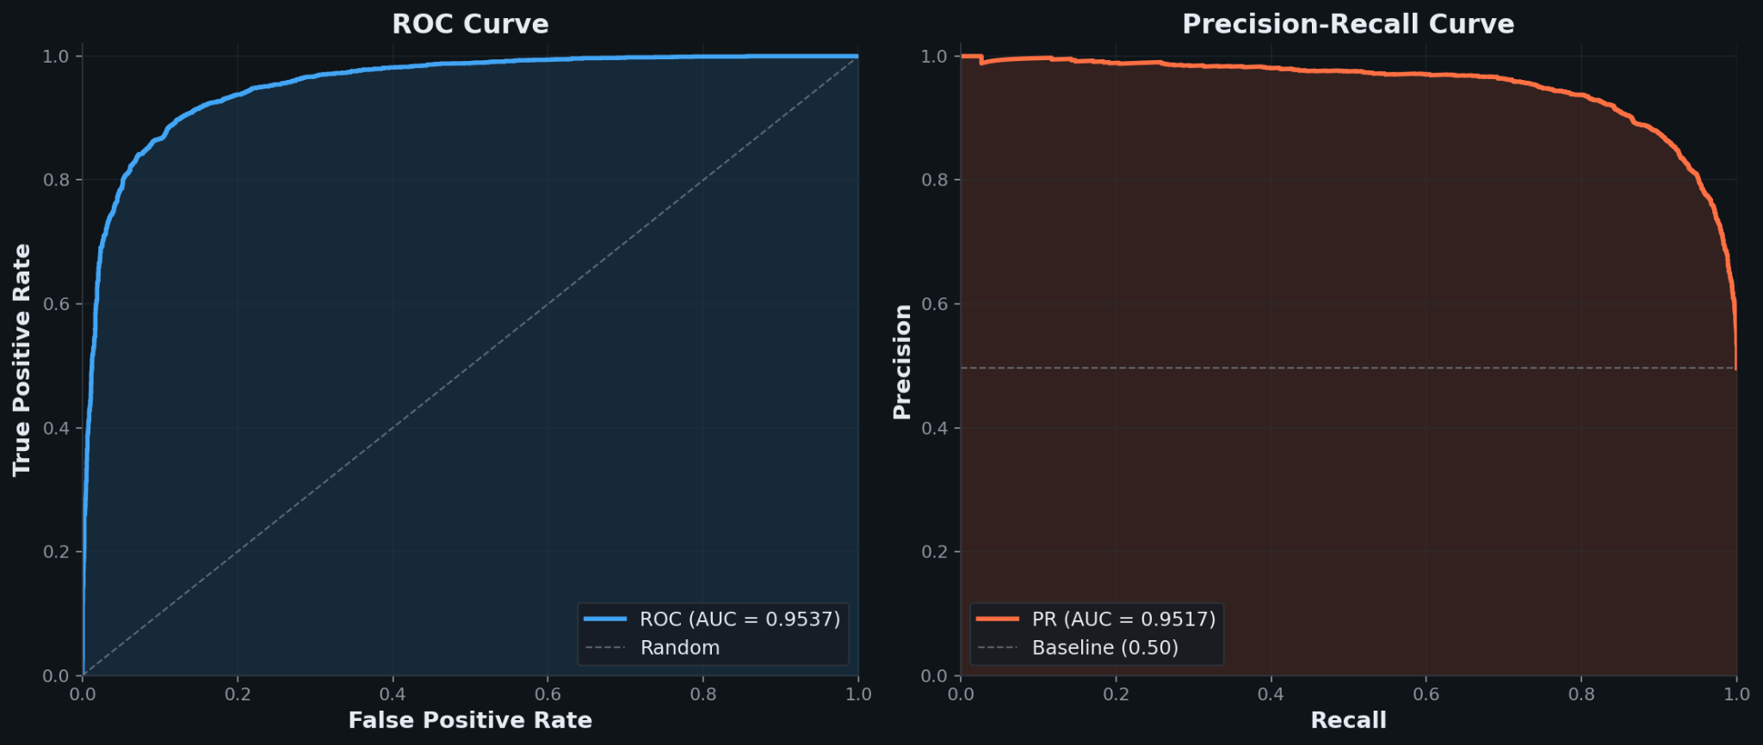
PERFORMANCE CURVE ANALYSIS
OptimalBitcoinGNN demonstrates exceptional discriminative power with high AUC scores across metrics.
Key Performance Metrics
01. ROC Curve Excellence
The ROC-AUC of 0.9537 indicates a very high true positive rate with minimal false positives, crucial for law enforcement.
02. Precision-Recall Stability
A PR-AUC of 0.9517 shows the model maintains high precision even at high recall levels, outperforming the 0.50 baseline.
03. Imbalance Robustness
The stability of the PR curve confirms that the model handles the inherent class imbalance of criminal vs. legitimate wallets effectively.

Slide 7

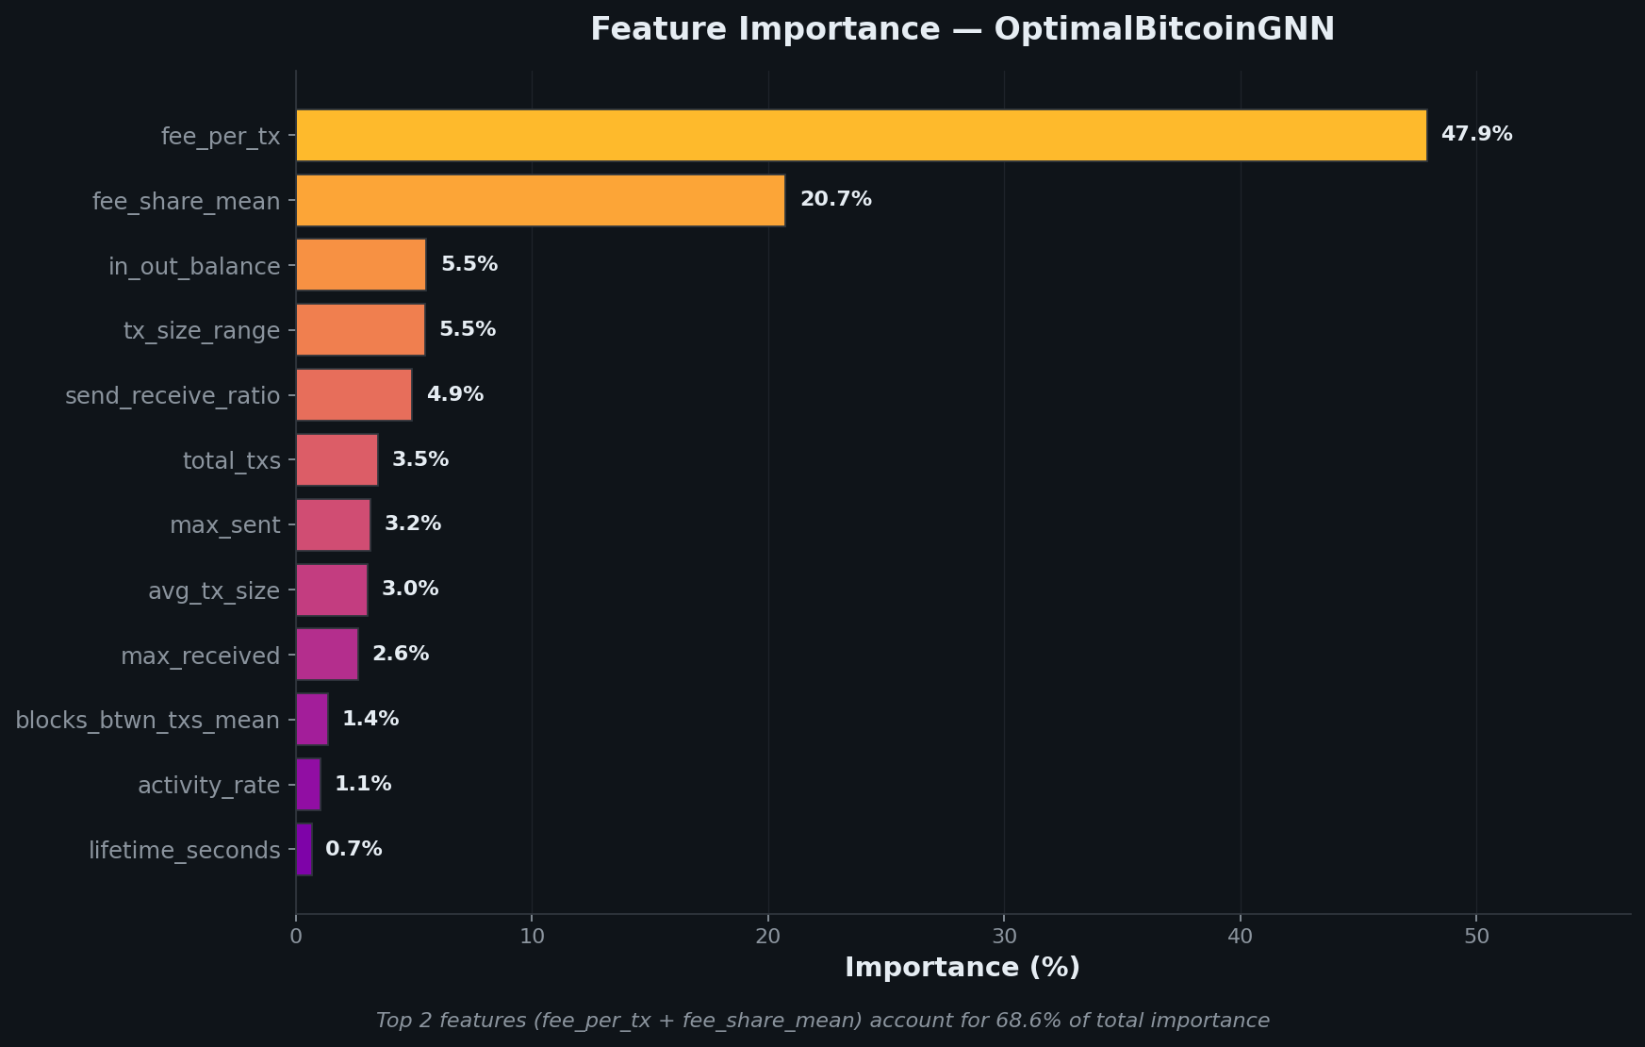
FEATURE IMPORTANCE ANALYSIS
Transaction fees and share mean dominate the decision-making process for OptimalBitcoinGNN.
Key Insights
01. Primary Drivers
The top 2 features (fee_per_tx and fee_share_mean) account for over 68% of the model's predictive weight.
02. Network Behavior
Wallet activity and transaction size emerge as secondary indicators, reflecting movement patterns of criminal entities.
03. Statistical Gini
The high concentration of importance suggests a robust but specialized signal for detecting illicit blockchain activity.

Slide 8
EVALUATION GOALS
Discrimination: distinguish between categories
Primary metrics: F1 score, ROC-AUC
Secondary metric: PR-AUC (more informative under class imbalance)
Baseline Comparison: whether complexity is justified
Primary metrics: change in F1 and ROC-AUC using identical 12 features
Secondary metric: architecture ablations (remove ghost embedding, hybrid readout, DropEdge)
Calibration: predicted probabilities reflect true outcomes
Primary metrics: Expected Calibration Error (ECE), Brier score
Secondary metric: reliability diagram (visual sanity check)
Generalization: performance on fresh wallets
Primary metrics: live precision@k, FPR and FNR delta vs. held-out test set
Secondary metric: KS test for score distribution shift

Slide 9

BENCHMARK RESULTS SUMMARY
Metric
OptimalGNN (Ours)
XGBoost Baseline
Basic GCN
Accuracy
88.39%
82.52%
72.98%
F1-Score
0.8864
0.8240
0.7520
Precision
86.14%
82.34%
69.05%
Recall (Sensitivity)
91.29%
82.45%
82.54%
ROC-AUC
0.9537
0.9085
0.8199
PR-AUC
0.9517
0.9074
0.8150
Brier Score
0.0881
0.1231
0.1773
ECE (Calibration)
0.0550
0.0269
0.0463

Slide 10
EXPERIMENT SETUP
Models compared:
OptimalBitcoinGNN (ours)
3-layer GATv2, 12 input features, hybrid readout, temperature scaling
XGBoost baseline
Same 12 features, no graph structure (tabular only)
Serves as a fast, strong baseline we must outperform
GNN Basline
Without ghost-node embedding (neighbors have zero features)
Without input-to-final residual connection
Training Setup (our model)
Optimizer: AdamW (learning rate 1e-3, weight decay 1e-4)
Loss: cross-entropy
Batch size: 64 ego-graphs
Early stopping: patience of 20 epochs based on validation F1
Best checkpoint: epoch 85 (validation F1 = 0.8794)

Slide 11
TECHNICAL CHALLENGES & LIMITATIONS
Data Acquisition Bottlenecks
API Rate Limits: mempool.space capped at 1 req every 2 sec
Incomplete Dataset: Only ~38k of 86k training graphs downloaded
Full Retrain Blocked: Insufficient data for final optimization
Miscalibration & Signal Loss
T-Scaling Inefficacy: Temperature barely moved (T=1.077)
Weak Per-Neighbor Signal: Ghost nodes lack real features; reliant on edge attention
Production & Diversity Risks
Evaluation Gap: No live-wallet or production address testing
Distribution Shift: High risk due to curated training data vs diverse live wallets
Depth Limitations: Per-neighbor signal weaker than full depth-2 ego graphs

Slide 12

PROJECT TIMELINE & SUBMISSION
WEEK 1
Data Completion
Finish graph downloads (~38k to 86k training graphs)
Meeting with project instructor for advice
WEEK 2
Model Retraining
Retrain GNN on full dataset
WEEK 3
Attempt Live-Wallet Eval
Build eval set (200 addresses) + measure precision@k
WEEK 4
Deployment
Deploy backend + frontend to university server
WEEK 5
Release & Report
write detailed evaluation report
WEEK 6
Final Prep
Build final slide deck
WEEK 7
Buffer & Polish
Buffer week for polish + dry runs
FINAL SUBMISSION: JUNE 25

